Slide 1


Gregory Siegfried
December 21st, 2021

Slide 2

Outline
Executive Summary
Introduction
Methodology
Results
Conclusion
Appendix
<number>
Notes:
<number>

Slide 3
Executive Summary
Summary of methodologies
Summary of all results
2

Slide 4
Introduction
Space X, our biggest competitor, have been able to reuse their Falcon 9 first stage boosters, to allow an entry price of $62 million for orbital launches.
Our company, Space Y, need to figure out launch success and booster reuse-ability, to allow for better analysis in contract bidding.
Our question:
Can we determine the price of a Space X launch based on the success of reusing the first stage?
3

Slide 5

4

Slide 6
Methodology
Data collection methodology:
Describe how data was collected
Perform data wrangling
Describe how data was processed
Perform exploratory data analysis (EDA) using visualization and SQL
Perform interactive visual analytics using Folium and Plotly Dash
Perform predictive analysis using classification models
How to build, tune, evaluate classification models
4
Notes:
<number>

Slide 7
Data Collection
Describe how data sets were collected.
You need to present your data collection process use key phrases and flowcharts
6

Slide 8
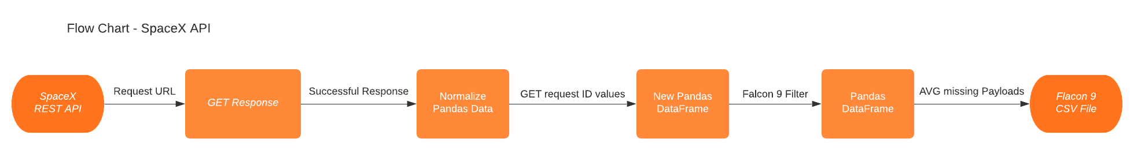
Data Collection – SpaceX API
https://github.com/siegfriedgreg/IBM-Data-Science-Coursera/blob/main/Capstone%20Data_Science/Lab%20-%201%20-%20SpaceX-API%20Calls.ipynb
7

Slide 9
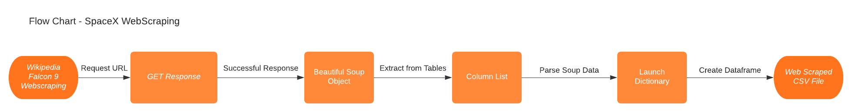
Data Collection - Scraping
https://github.com/siegfriedgreg/IBM-Data-Science-Coursera/blob/main/Capstone%20Data_Science/Lab%20-%202%20-%20SpaceX-Web%20Scraping.ipynb
8

Slide 10
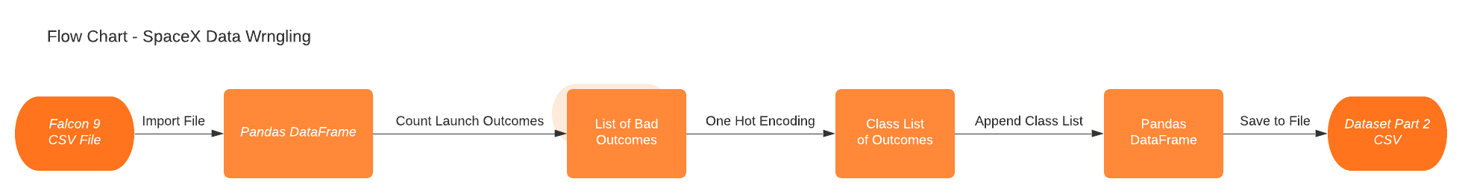
Data Wrangling
https://github.com/siegfriedgreg/IBM-Data-Science-Coursera/blob/main/Capstone%20Data_Science/Lab%20-%203%20-%20SpaceX-Data%20Wrangling.ipynb
9

Slide 11
EDA with Data Visualization
Using catplot, scatterplot, bar chart, and line plot, to visualize the data across Launch Site, Flight Number, Payload Mass, and Orbit.
All points being plotted are colored by a successful or unsuccessful launch
Examples: Slides 17-23
https://github.com/siegfriedgreg/IBM-Data-Science-Coursera/blob/main/Capstone%20Data_Science/Lab%20-%204%20-%20EDA%20Data%20Visualization.ipynb
10

Slide 12
EDA with SQL
Selected Items to List:
Distinct Launch Sites
Total or Average Payload Across Features
Booster Versions on Payload Ranges
Landing Outcomes for Dates
Examples: Slides 24-33
https://github.com/siegfriedgreg/IBM-Data-Science-Coursera/blob/main/Capstone%20Data_Science/Lab%20-%205%20-%20EDA%20SQL%20Queries.ipynb
11

Slide 13
Build an Interactive Map with Folium
Markers and Circles were added to aid in locating launch sites and zooming levels.
Marker Clusters were added to aid in visualizing launch outcomes for each site.
Feature Lines and Distances were added to show proximity to Cities, Rail Roads, Highways, and Coastlines.
Examples: Slides 34-37
https://github.com/siegfriedgreg/IBM-Data-Science-Coursera/blob/main/Capstone%20Data_Science/Lab%20-%206%20-%20Folium%20Map.ipynb
12

Slide 14
Build a Dashboard with Plotly Dash
Selecting one or all launch sites you can:
1) see the launch outcomes as a percentage in a pie chart.
2) see the launch outcomes per booster across all payload ranges, with a slider to narrow down values as a scatter plot.
Examples: Slides 38-41
https://github.com/siegfriedgreg/IBM-Data-Science-Coursera/blob/main/Capstone%20Data_Science/Lab%20-%207%20-%20SpaceX%20Dash%20App.py
13

Slide 15
Predictive Analysis (Classification)
A data set had one hot encoded features such as Orbit, Launch Site, Landing Pad, and Serial were set as X features. Another data set was used to confirm the Class outcomes as Y features.
The X and Y features were used to train-test-split the data sets.
GridSearch was used to find the best parameters for K Nearest Neighbors, Logistic Regression, Decision Tree, and Support Vector Machine.
Examples: Slides 42-44
https://github.com/siegfriedgreg/IBM-Data-Science-Coursera/blob/main/Capstone%20Data_Science/Lab%20-%208%20-%20SpaceX%20Predictive%20Analysis.ipynb
14

Slide 16
Results
Exploratory data analysis results
Interactive analytics demo in screenshots
Predictive analysis results
16
Notes:
<number>

Slide 17


Slide 18
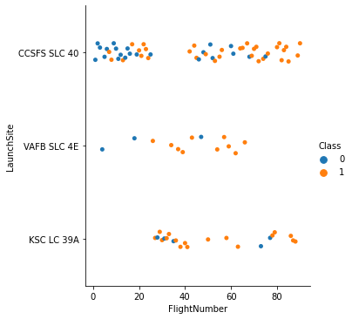
Flight Number vs. Launch Site
Class coloring indicates launch outcome. 0 is unsuccessful and 1 is successful.
16

Slide 19
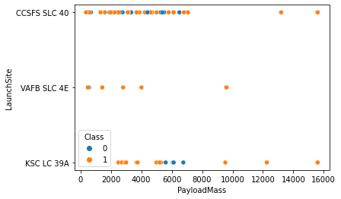
Payload Mass vs. Launch Site
Class coloring indicates launch outcome. 0 is unsuccessful and 1 is successful.
18

Slide 20
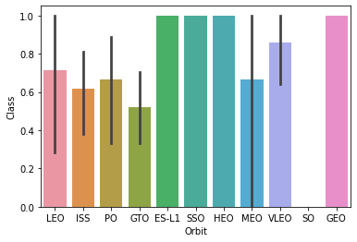
Orbit Type vs. Success Rate
Show a bar chart for the success rate of each orbit type
Show the screenshot of the scatter plot with explanations
19

Slide 21
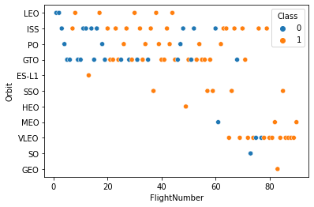
Flight Number vs. Orbit Type
Show a scatter point of Flight number vs. Orbit type
Show the screenshot of the scatter plot with explanations
20

Slide 22
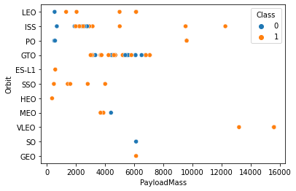
Payload Mass vs. Orbit Type
Show a scatter point of payload vs. orbit type
Show the screenshot of the scatter plot with explanations
21

Slide 23
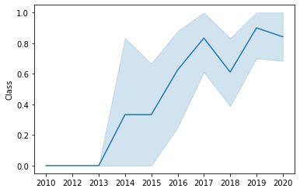
Launch Success Yearly Trend
Show a line chart of yearly average success rate
Show the screenshot of the scatter plot with explanations
22

Slide 24
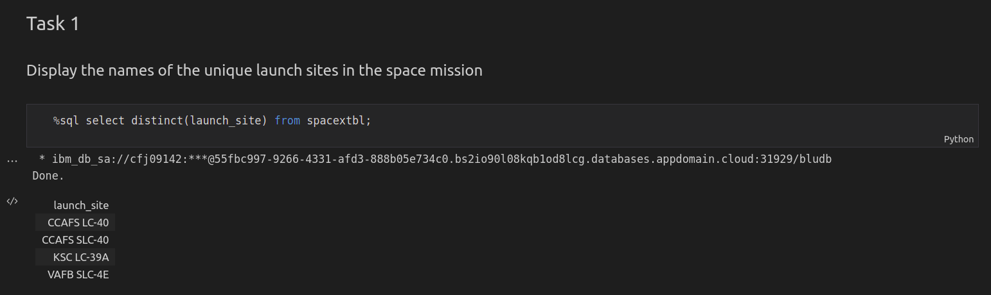
All Launch Site Names
23

Slide 25
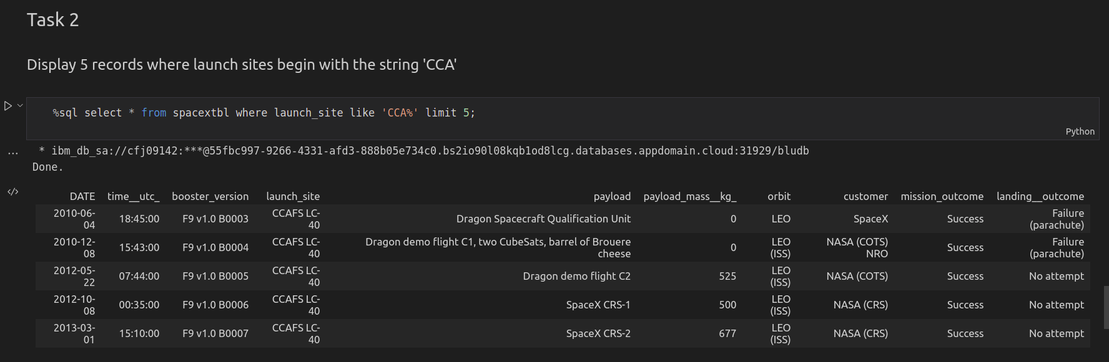
Launch Site Names Begin with 'CCA'
24

Slide 26
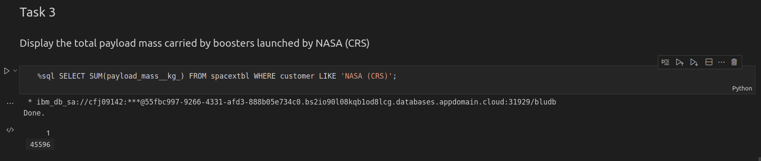
Total Payload Mass
25

Slide 27
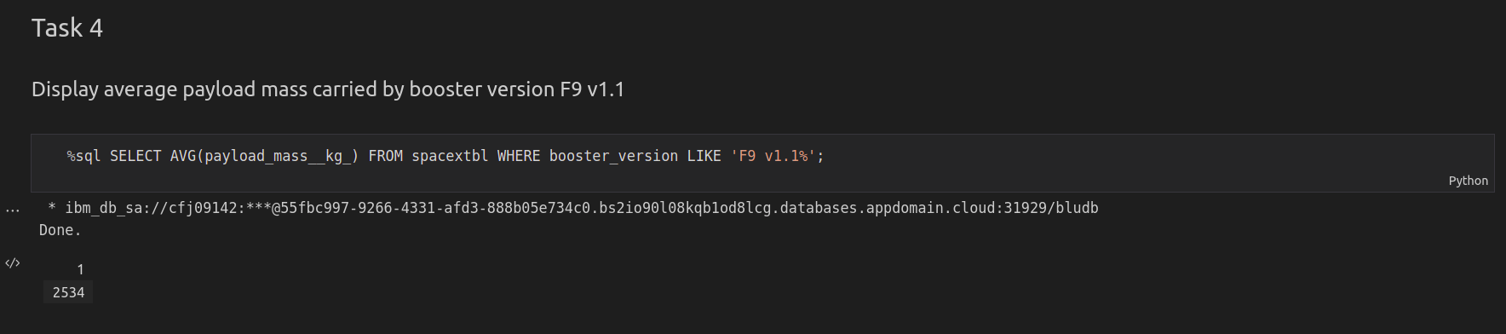
Average Payload Mass by F9 v1.1
26

Slide 28
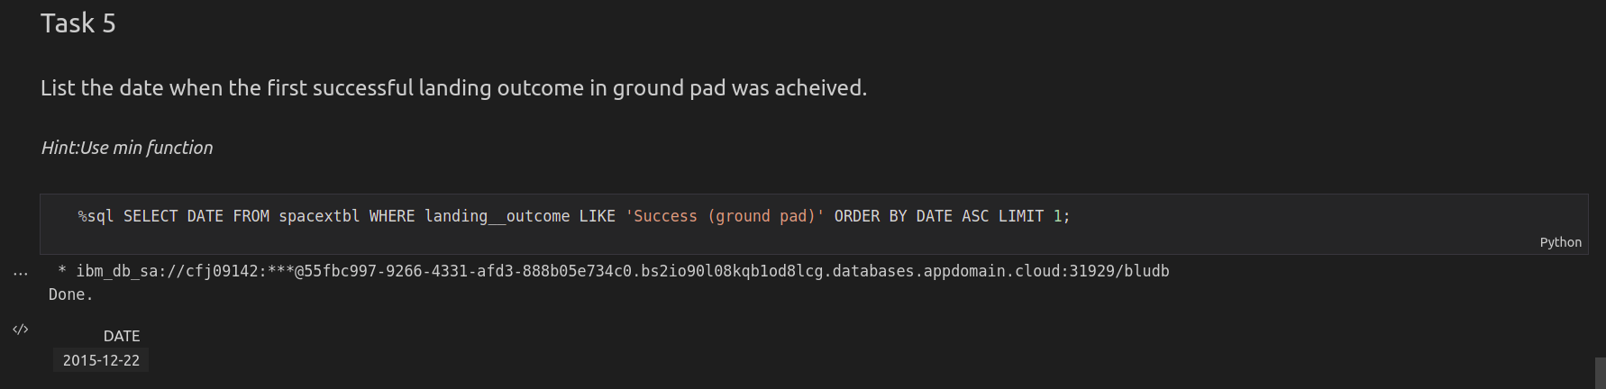
First Successful Ground Landing Date
27

Slide 29
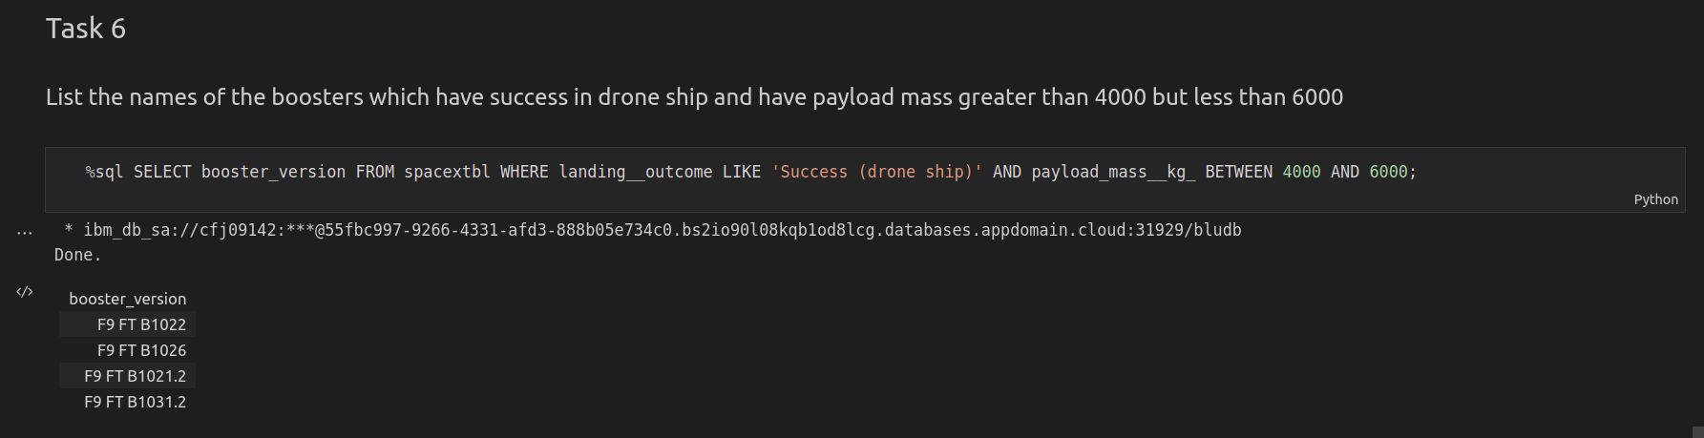
Successful Drone Ship Landing with Payload between 4000 and 6000
28

Slide 30
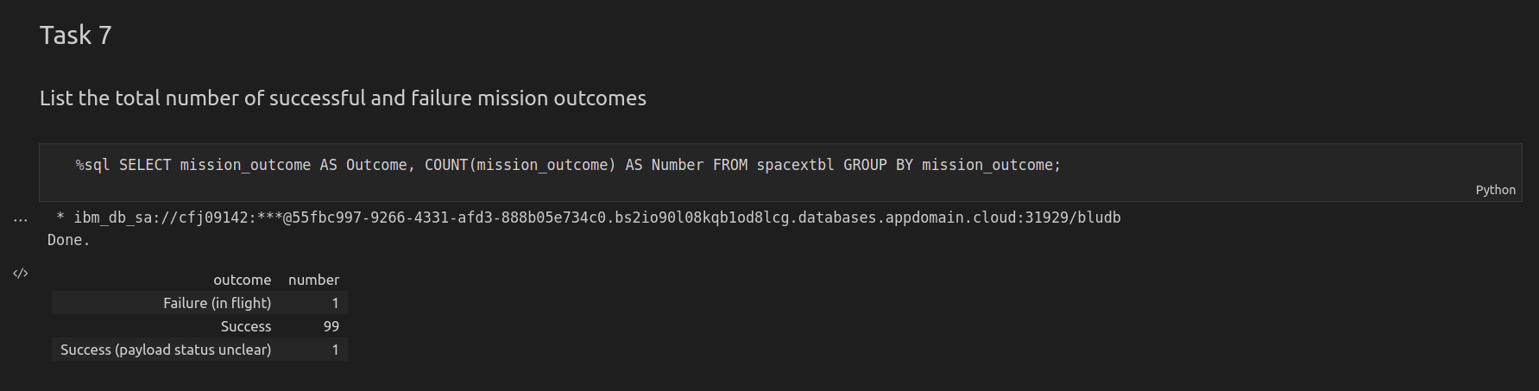
Total Number of Successful and Failure Mission Outcomes
29

Slide 31
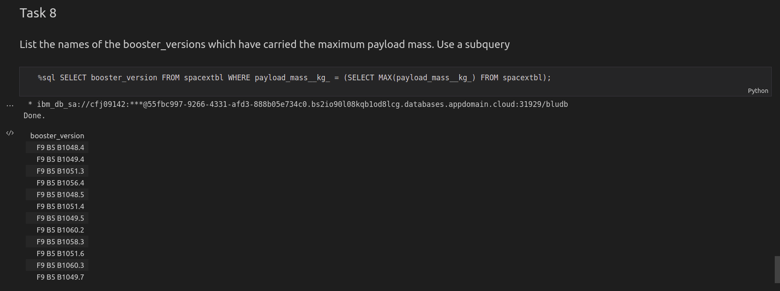
Boosters Carried Maximum Payload
30

Slide 32
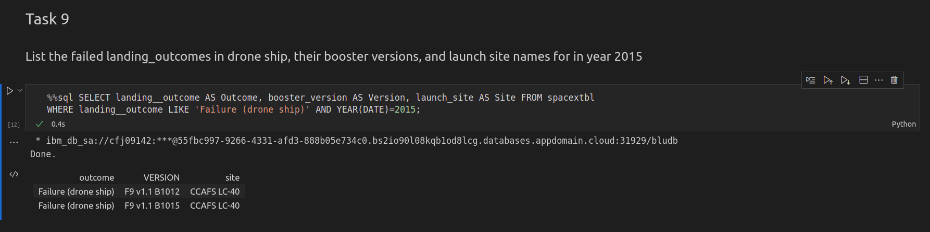
2015 Launch Records
31

Slide 33
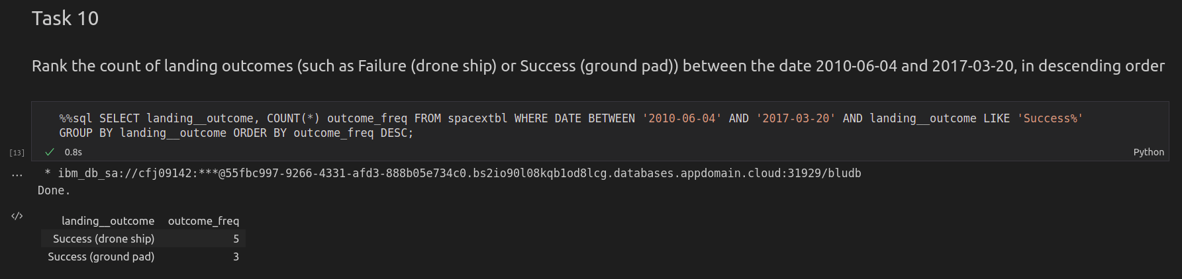
Rank Landing Outcomes Between 2010-06-04 and 2017-03-20
32

Slide 34


Slide 35
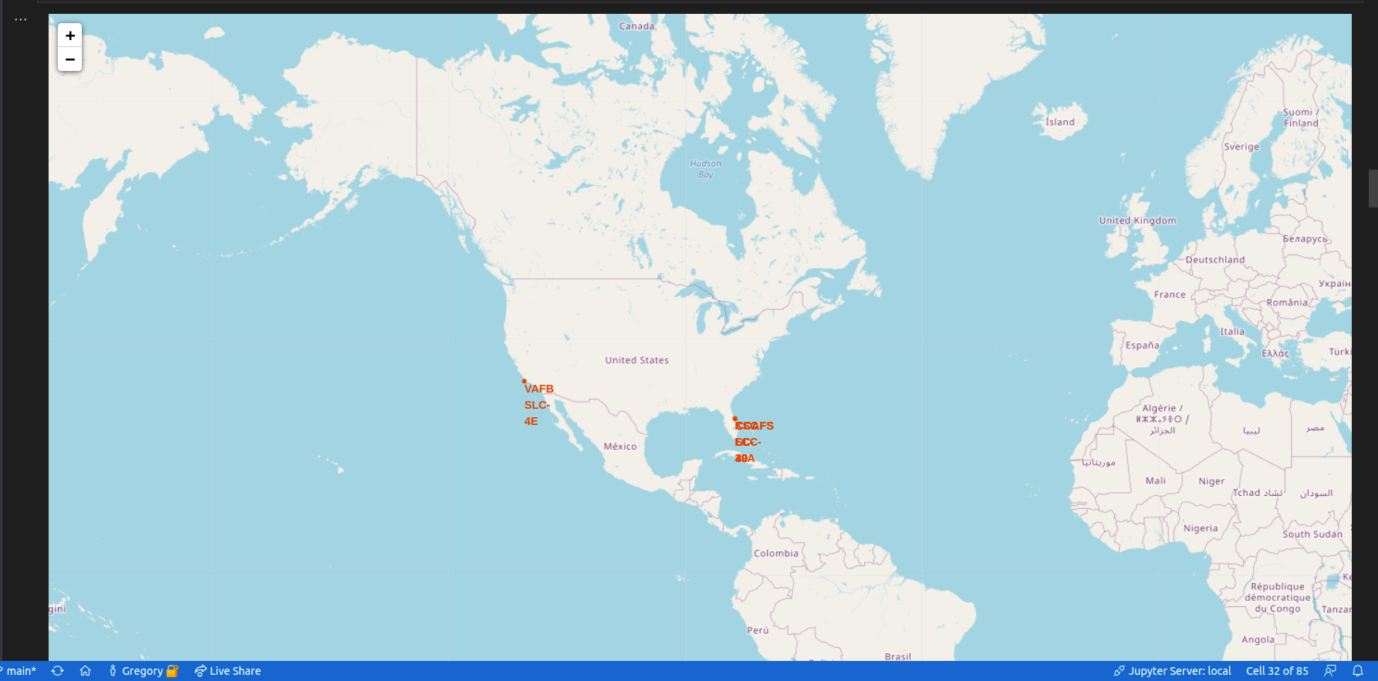
Folium Map - Launch Sites
Global screen shot of folium map with launch site locations.
33

Slide 36
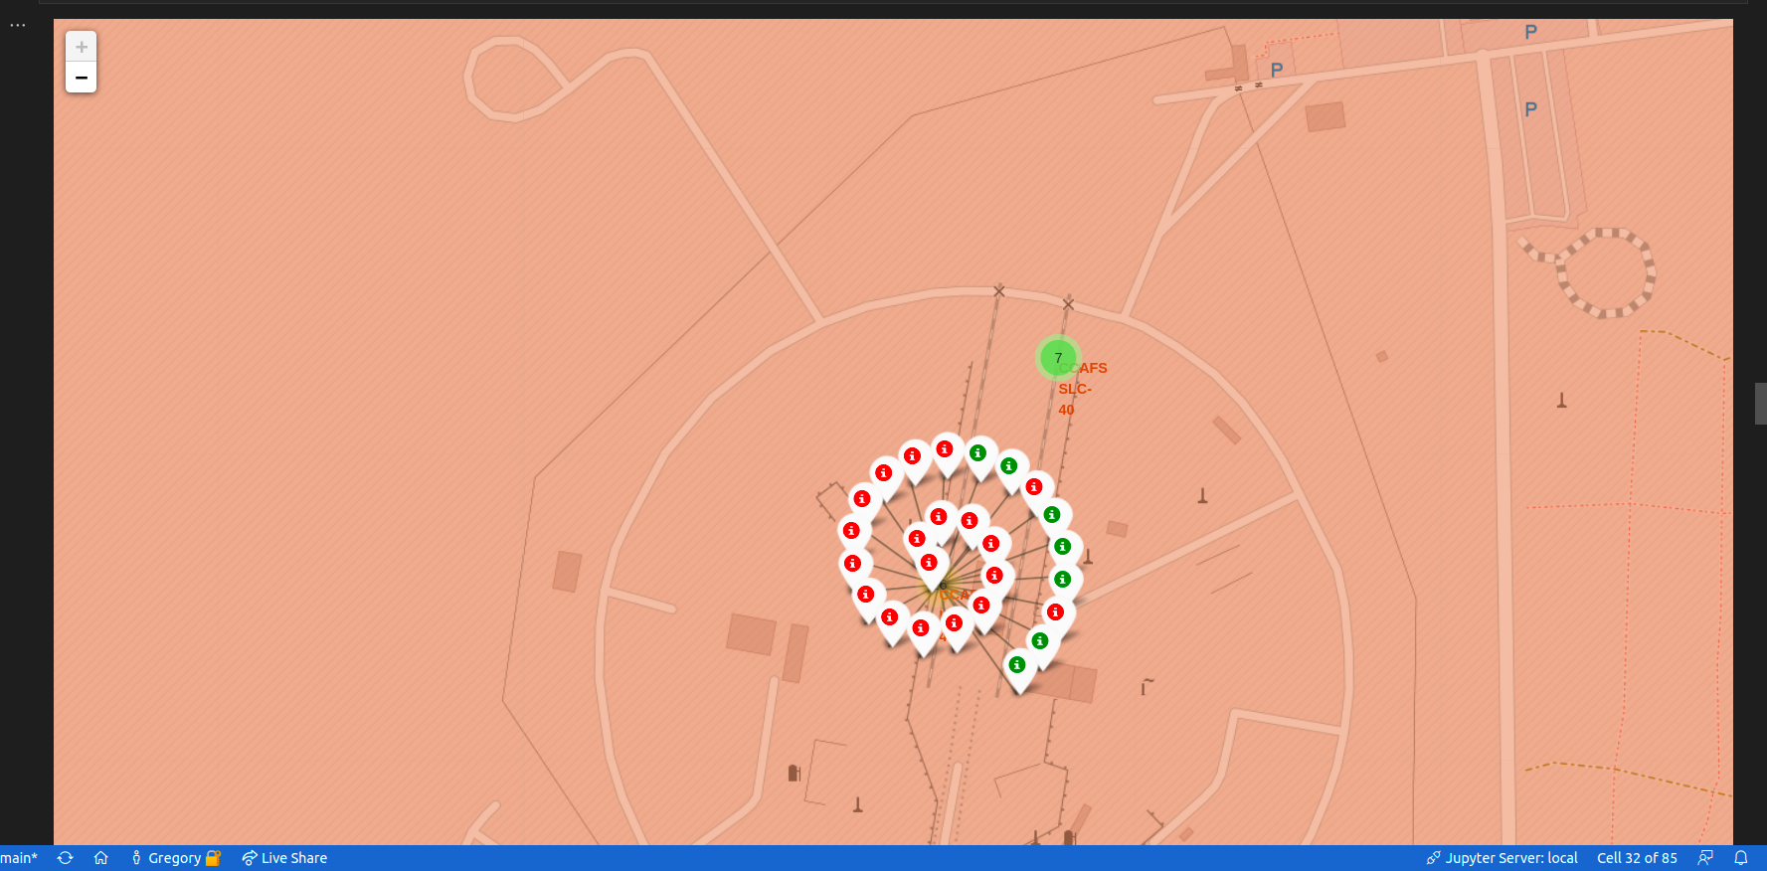
Folium Map – Launch Outcome Markers
Launch outcome markers for site: CCAFS LC-40
35

Slide 37
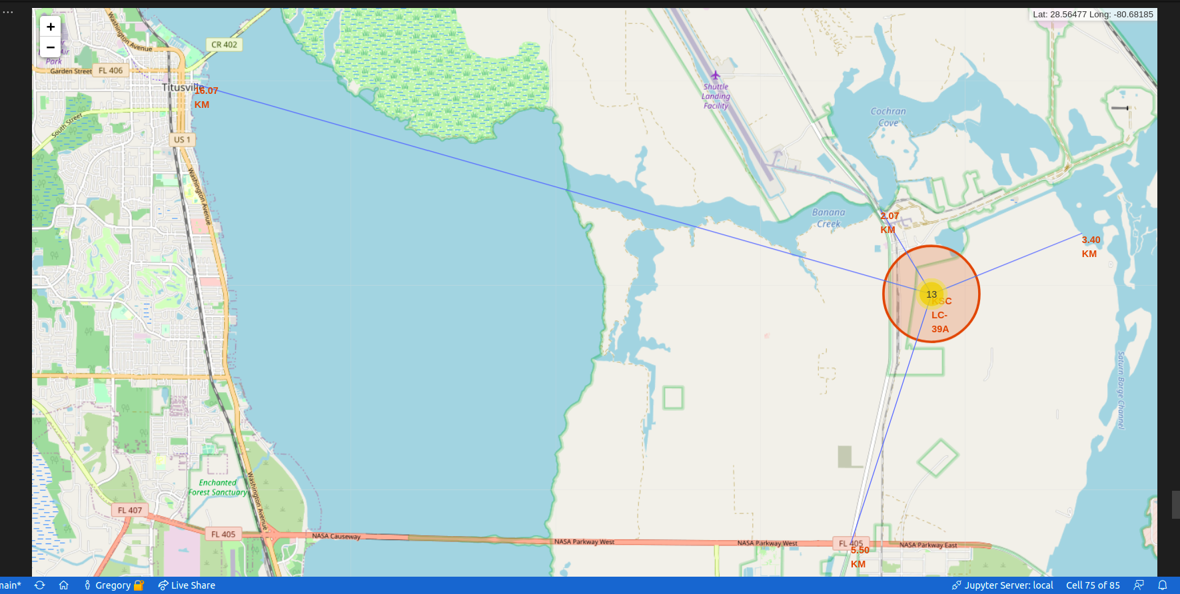
Folium Map – Local Feature Markers
Locations of features around site: KSC LC-39A
<number>

Slide 38


Slide 39
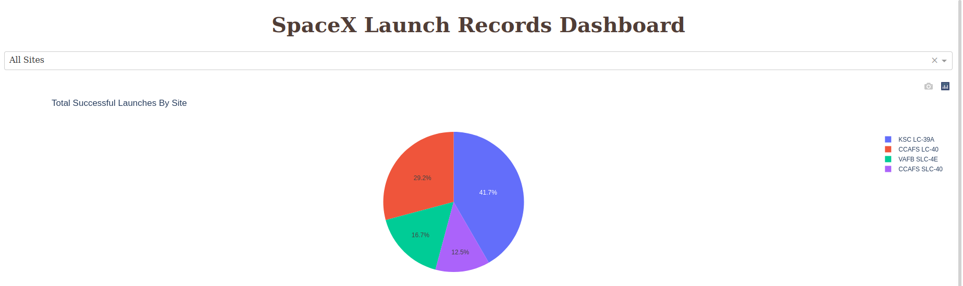
Dash – Successful Outcome by Site
Successful landings are shown across all launch sites
<number>

Slide 40
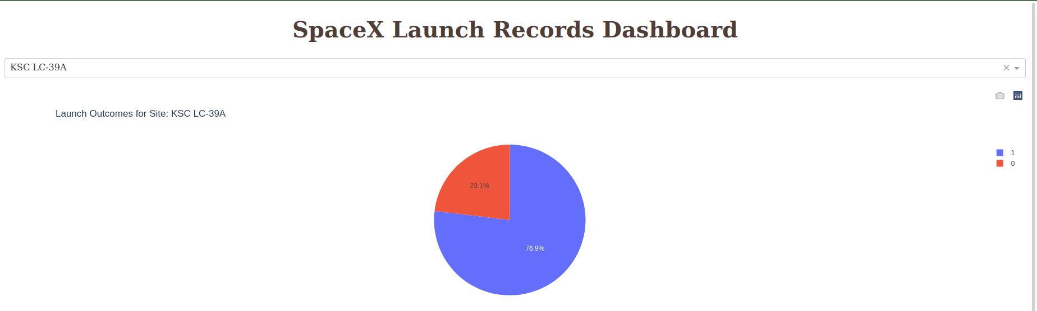
Dash – Most Successful Site
Successful landings are coded 1 and Unsuccessful as 0
<number>

Slide 41
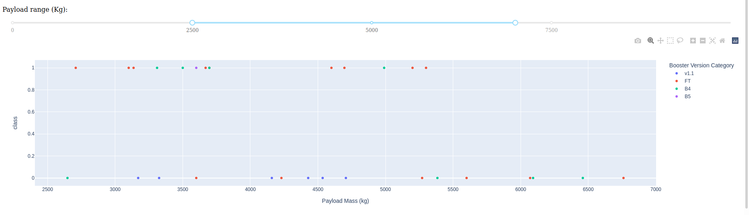
Dash – Payload Mass vs. Launch Outcome
All sites with payload range between 2500 to 7000 kg, booster version by color.
<number>

Slide 42


Slide 43
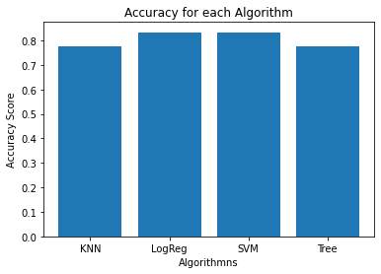
Classification Accuracy
The logistic regression algorithm, or LogReg, performed the best.
<number>

Slide 44
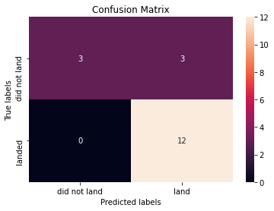
Confusion Matrix
The Logistic Regression Confusion Matrix has 3 false positives where it predicted a flight would land but it did not.
<number>

Slide 45
Conclusions
Point 1
Point 2
Point 3
Point 4
…
<number>

Slide 46
Appendix
Include any relevant assets like Python code snippets, SQL queries, charts, Notebook outputs, or data sets that you may have created during this project
45
Notes:
<number>

Slide 47


